Slide 1

50.039 Theory and Practice of Deep Learning W3-2 Introduction to Deep Learning using the PyTorch framework
Matthieu De Mari

Slide 2
Introduction (Week 3)
What is the PyTorch library and its benefits?
What is a PyTorch tensor object and its typical attributes?
How to implement some typical tensor operations?
What is broadcasting on tensors?
What are tensor locations in terms of computation?
How to transform our original NumPy shallow Neural Network class so it uses PyTorch now instead?
How to implement a forward, loss and accuracy metric in PyTorch?
What are some measurable performance benefits of using PyTorch over NumPy and GPUs over CPUs?

Slide 3
Introduction (Week 3)
What is the autograd/backprop module in PyTorch, and how does it use a computational graph to compute all derivatives?
How to use the autograd to implement derivatives and a vanilla gradient descent?
How to implement backprop in PyTorch for our shallow Neural Network class?
How to use PyTorch to implement advanced optimizers?
How to use PyTorch to implement advanced initializers?
How to use PyTorch to implement regularization?
How to finally revise our trainer function to obtain a minimal, yet complete Neural Network in PyTorch?

Slide 4
Introduction (Week 3)
What are the Dataset and Dataloader objects in PyTorch?
How to implement a custom Dataloader and Dataset object in PyTorch?
How to move from binary classification to multi-class classification?
How to adjust output probabilities using the softmax function?
How to change the cross-entropy loss so it works in multi-class classification?
How to implement building blocks in PyTorch?
How to implement and train our first Deep Neural Network?
What are additional good practices in PyTorch?

Slide 5
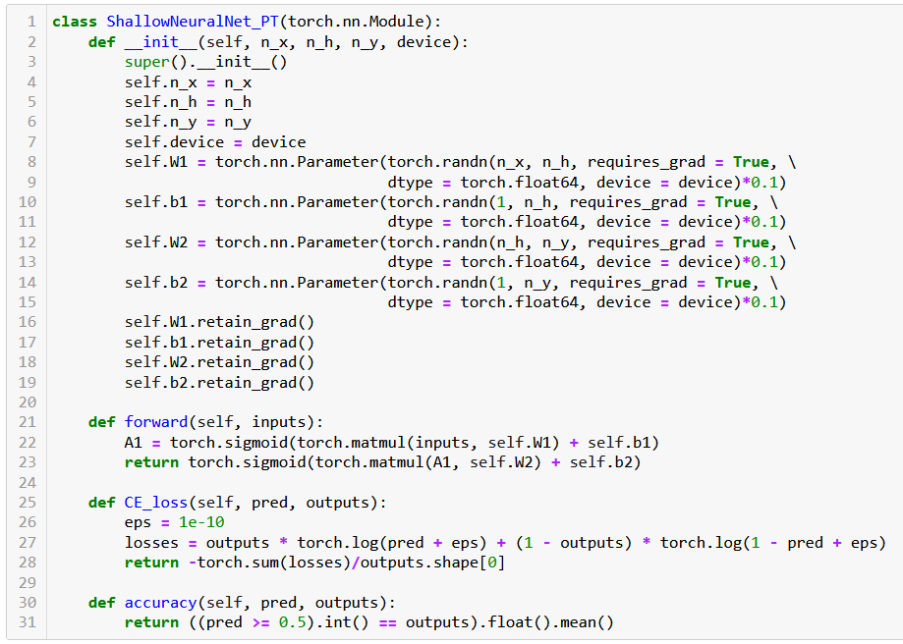

Slide 6
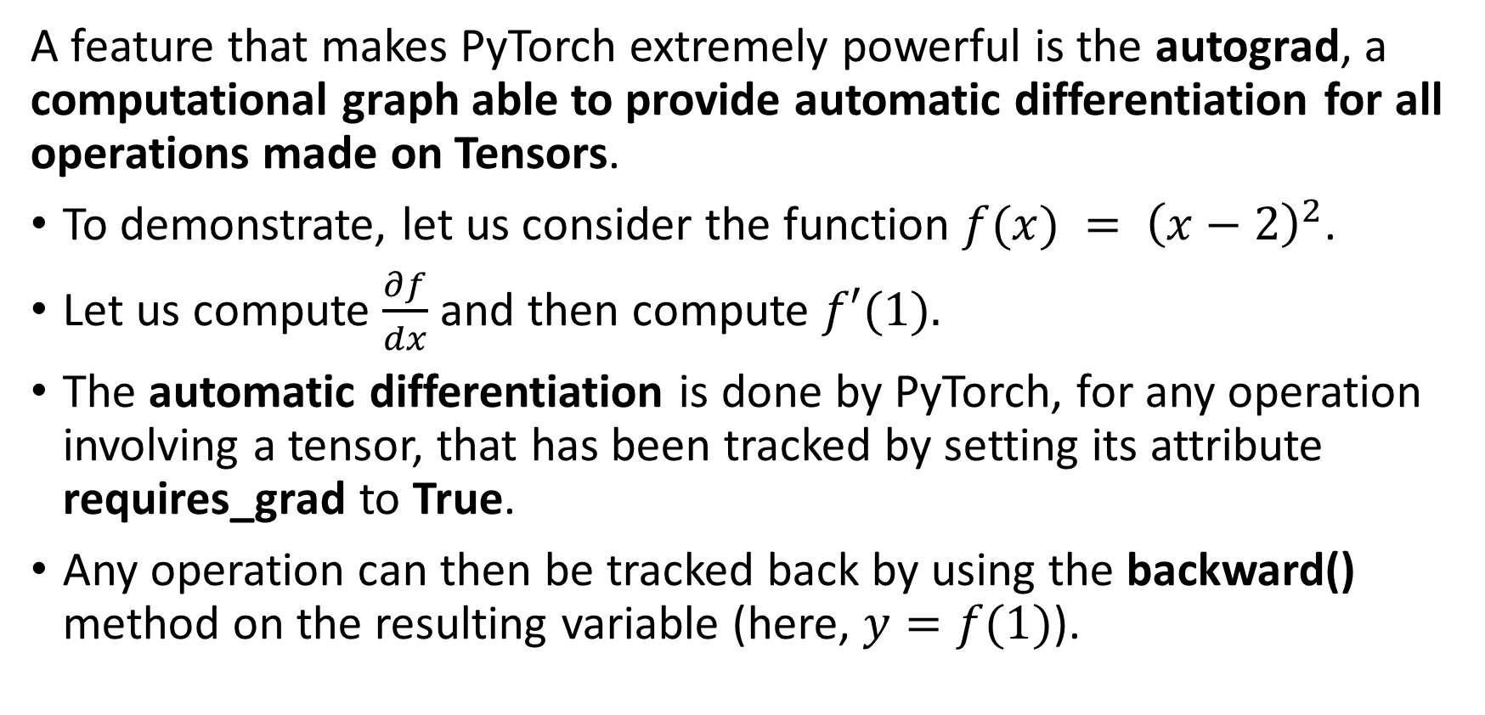
Autograd, the PyTorch beast
A feature that makes PyTorch extremely powerful is the autograd, a computational graph able to provide automatic differentiation for all operations made on Tensors.
To demonstrate, let us consider the function $f(x) = {\left(x−2\right)}^{2}$.
Let us compute $\frac{∂f}{dx}$ and then compute $f′(1).$
The automatic differentiation is done by PyTorch, for any operation involving a tensor, that has been tracked by setting its attribute requires_grad to True.
Any operation can then be tracked back by using the backward() method on the resulting variable (here, $y=f(1)$).

Slide 7
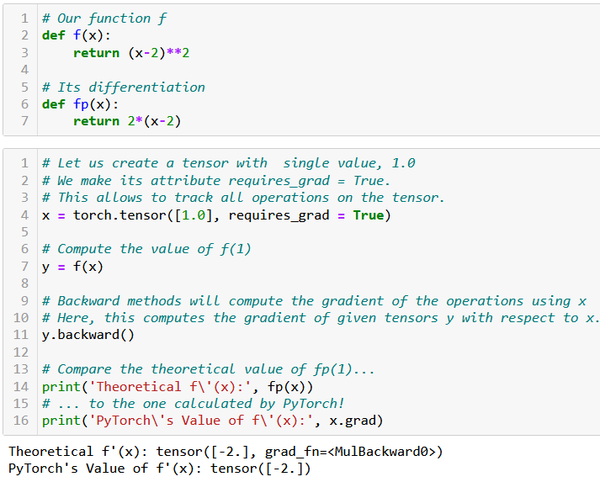
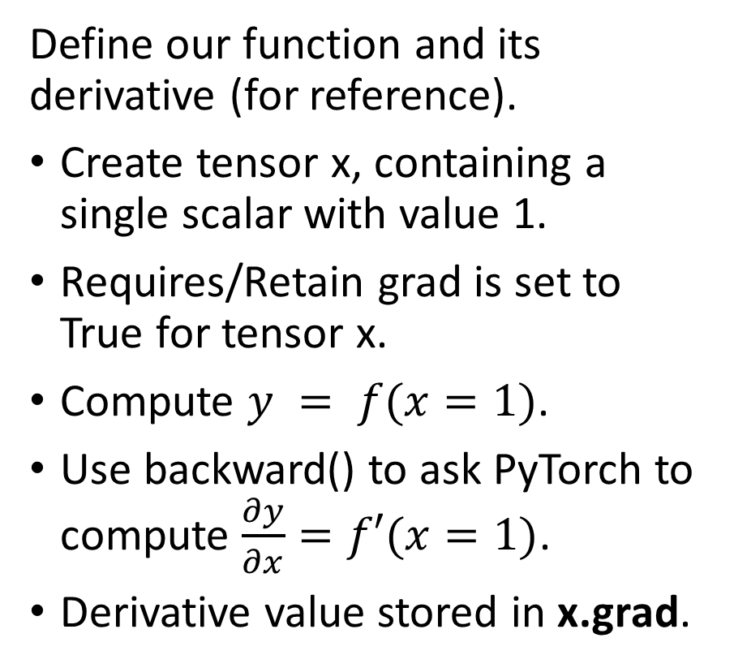
Autograd in action
Define our function and its derivative (for reference).
Create tensor x, containing a single scalar with value 1.
Requires/Retain grad is set to True for tensor x.
Compute $y = f(x=1)$.
Use backward() to ask PyTorch to compute $\frac{∂y}{∂x}=f′(x=1)$.
Derivative value stored in x.grad.

Slide 8
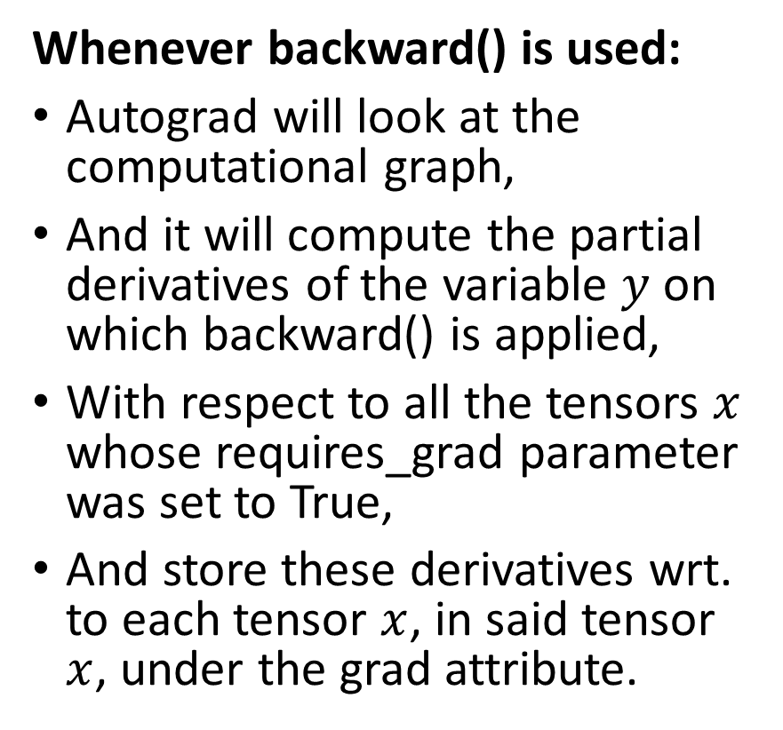
Autograd in action
Whenever backward() is used:
Autograd will look at the computational graph,
And it will compute the partial derivatives of the variable $y$ on which backward() is applied,
With respect to all the tensors $x$ whose requires_grad parameter was set to True,
And store these derivatives wrt. to each tensor $x$, in said tensor $x$, under the grad attribute.

Slide 9
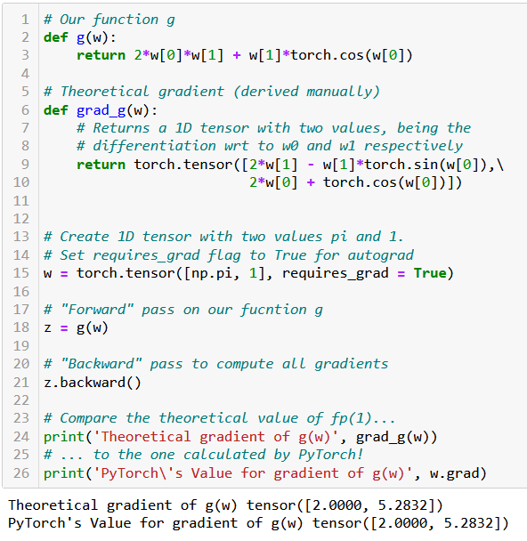
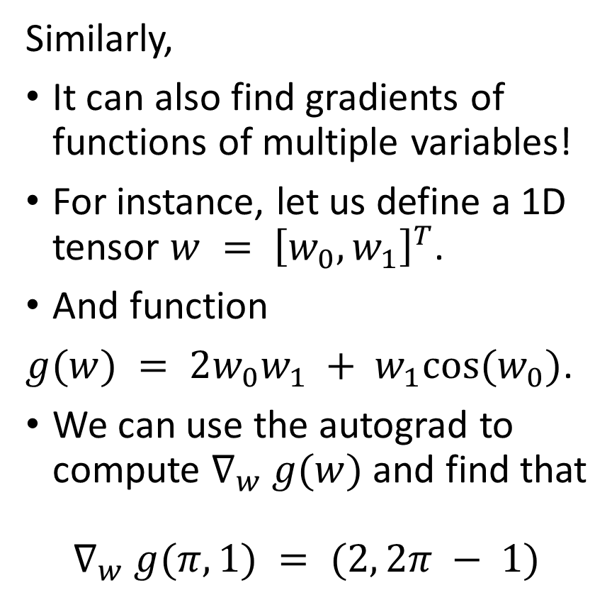
Autograd in action
Similarly,
It can also find gradients of functions of multiple variables!
For instance, let us define a 1D tensor $w = {\left[w_{0}, w_{1}\right]}^{T}$.
And function
$g(w) = 2w_{0}w_{1} + w_{1}cos(w_{0})$.
We can use the autograd to compute $∇_{w} g(w)$and find that
$$∇_{w} g(π,1) = (2, 2π − 1)$$

Slide 10
Autograd, in short
The autograd is one of the most powerful features of the PyTorch framework, and why we like it so much for training Neural Networks.
Thanks to autograd, we do not need to calculate the gradients for any of our future gradient descent rules, manually again! (yay!)
The counterpart however is that all operation must involve tensors and must use PyTorch functions and methods... (but that is ok).
You do not need to know how it implements the computation of all gradients in the background, but if you are curious, have a look at: https://pytorch.org/blog/computational-graphs-constructed-in-pytorch/.

Slide 11
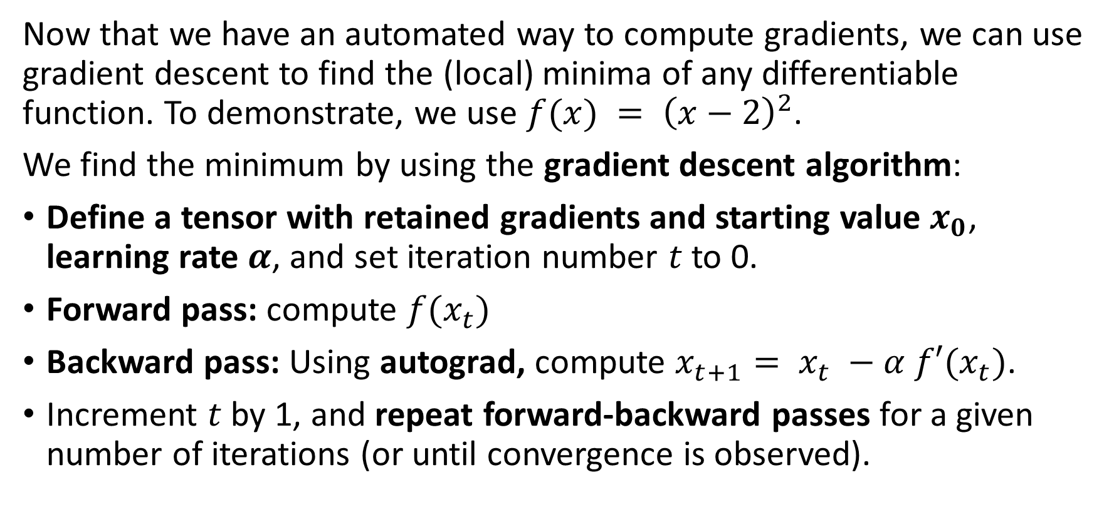
Implementing gradient descent with autograd
Now that we have an automated way to compute gradients, we can use gradient descent to find the (local) minima of any differentiable function. To demonstrate, we use $f(x) = {\left(x−2\right)}^{2}$.
We find the minimum by using the gradient descent algorithm:
Define a tensor with retained gradients and starting value $x_{0}$, learning rate $α$, and set iteration number $t$ to 0.
Forward pass: compute $f(x_{t})$
Backward pass: Using autograd, compute $x_{t+1}= x_{t} −α f′(x_{t})$.
Increment $t$ by 1, and repeat forward-backward passes for a given number of iterations (or until convergence is observed).

Slide 12
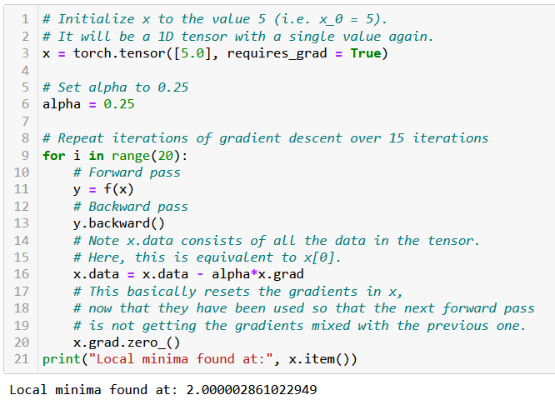
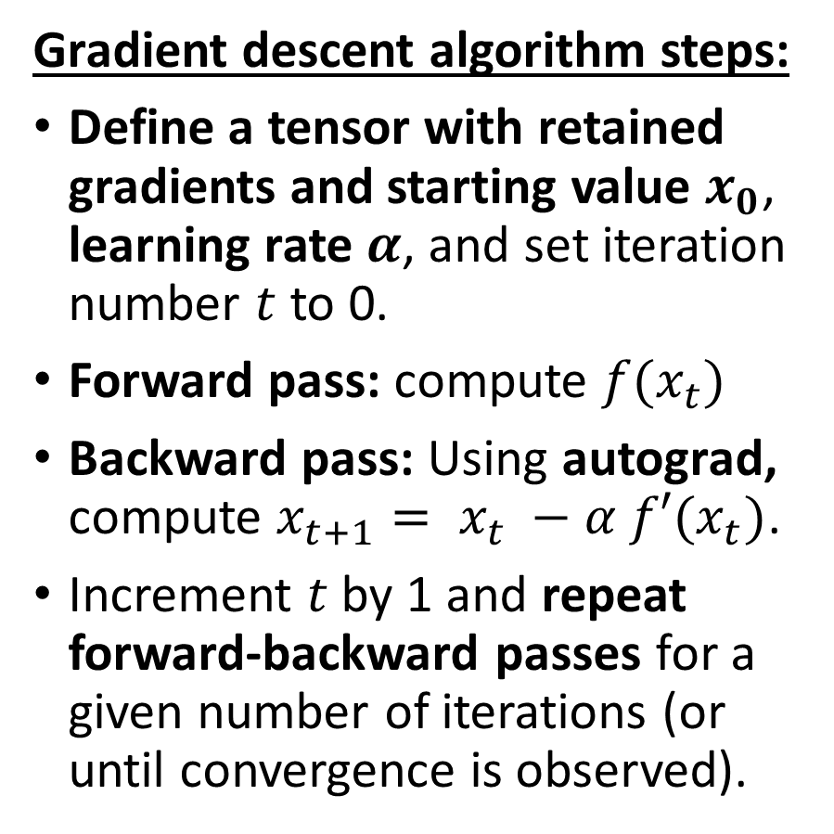
Implementing gradient descent with autograd
Gradient descent algorithm steps:
Define a tensor with retained gradients and starting value $x_{0}$, learning rate $α$, and set iteration number $t$ to 0.
Forward pass: compute $f(x_{t})$
Backward pass: Using autograd, compute $x_{t+1}= x_{t} −α f′(x_{t})$.
Increment $t$ by 1 and repeat forward-backward passes for a given number of iterations (or until convergence is observed).

Slide 13
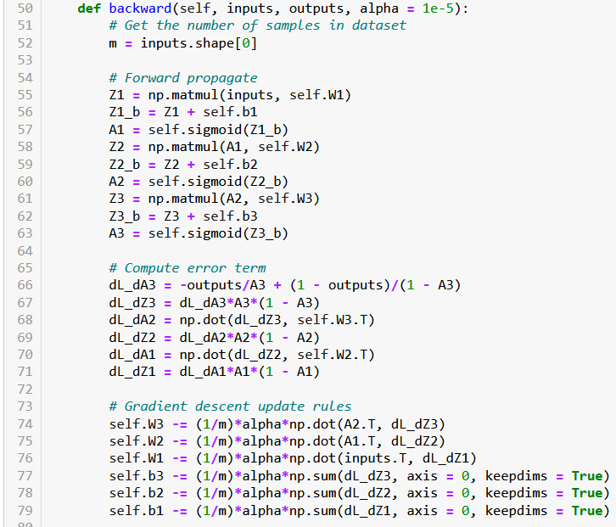
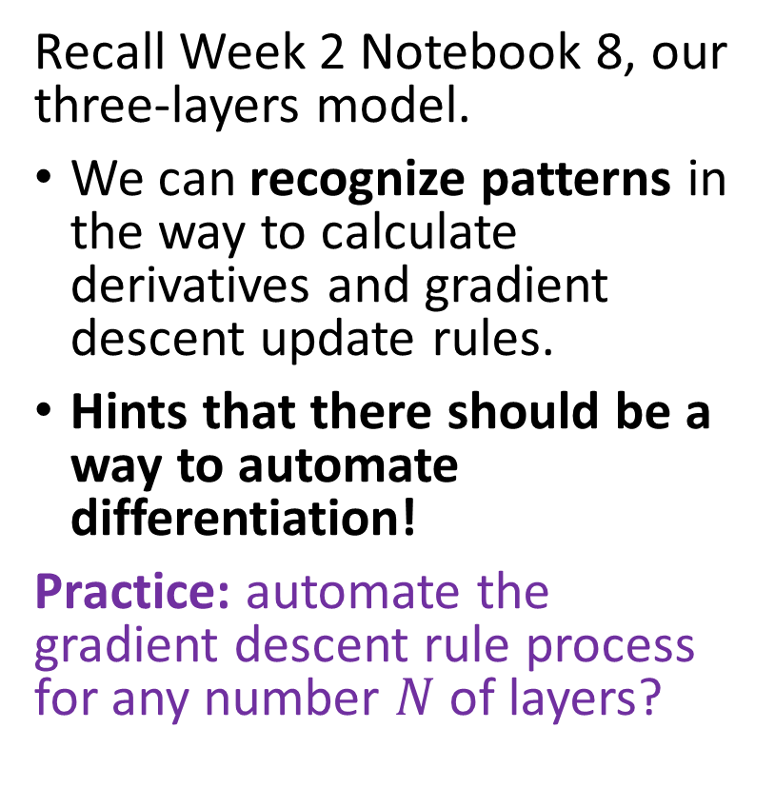
Intuition for our NN
Recall Week 2 Notebook 8, our three-layers model.
We can recognize patterns in the way to calculate derivatives and gradient descent update rules.
Hints that there should be a way to automate differentiation!
Practice: automate the gradient descent rule process for any number $N$ of layers?

Slide 14
Rewriting our backpropagation
In order to train our Neural Network using backprop, we rely on autograd to compute the gradient updates for us automatically.
For this reason,
There is no need for a backward() method as before to compute gradients and gradient descent update rules (built-in method for nn.Module classes, covered automatically by PyTorch autograd, yay!).
Our train() method will now consist of several iterations of
forward() pass and loss calculation,
gradient computation with the backward() method, used on loss,
and gradient descent updates on trainable parameters.

Slide 15
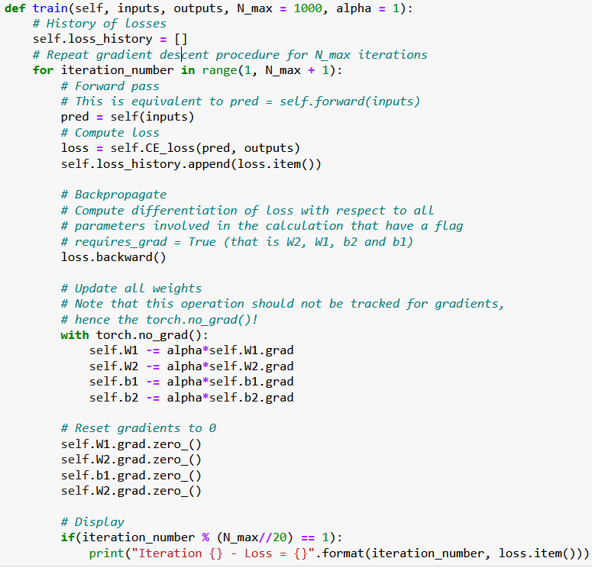
Backpropagation
Our train() method will be rewritten and now consists of several iterations of
forward() pass and loss calculation,
gradient computation with the backward() method, used on loss,
and gradient descent updates on trainable parameters.

Slide 16
Backpropagation
Important note:
Using with torch.no_grad(): tells PyTorch that the operations should not be tracked by the autograd.
Indeed, when performing gradient update for a trainable parameter, we do not want to update gradients for other trainable parameters!

Slide 17
Backpropagation
Important note #2:
Also, do not forget to reset your gradients to zero before the next iteration!
Otherwise, they will accumulate (and we do not want that!)
This can be simply done with grad.zero_().

Slide 18
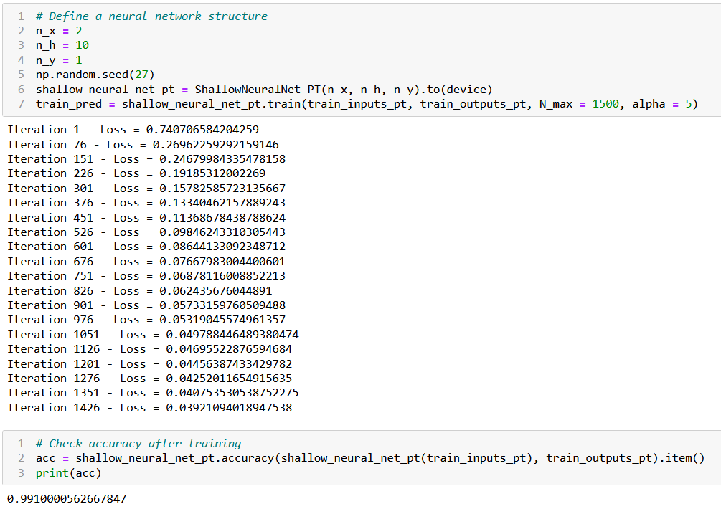
Trying our trainer function… Works!

Slide 19
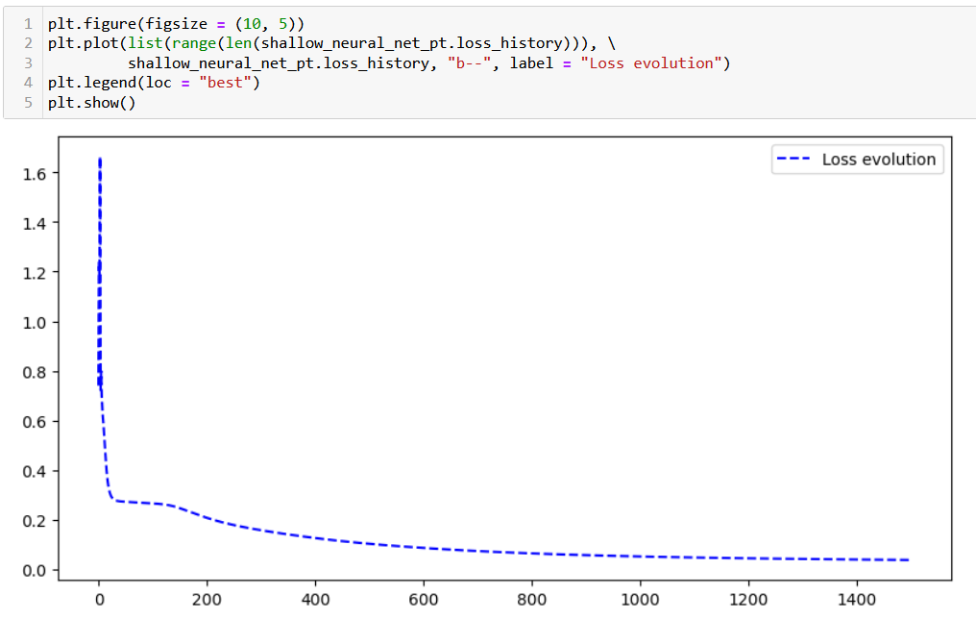
Trying our trainer function… Works!

Slide 20
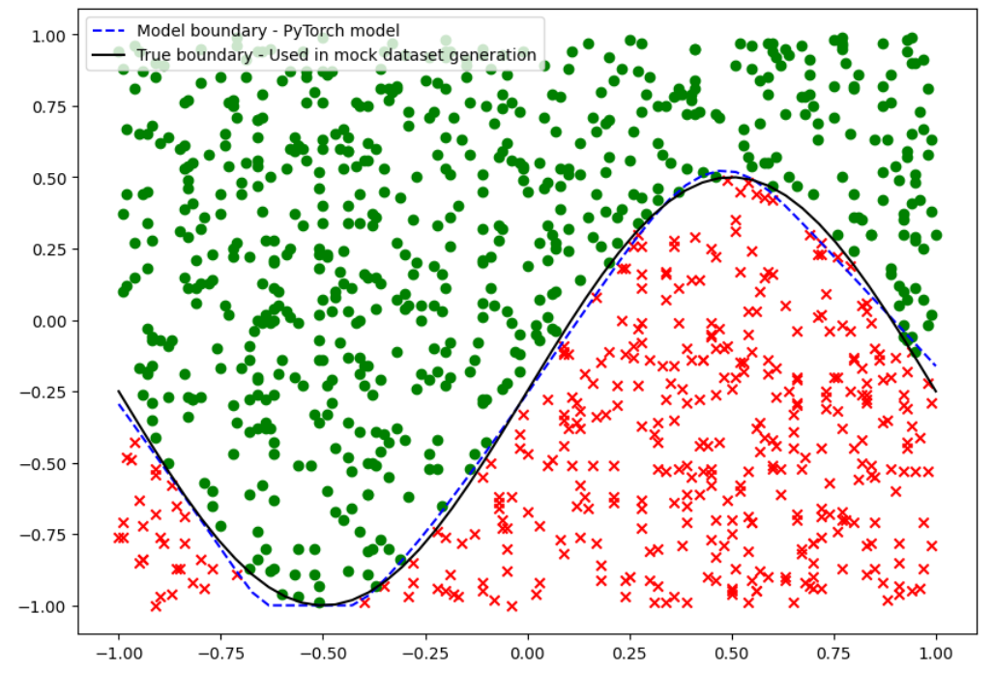
Trying our trainer function… Works!

Slide 21
Using PyTorch losses and metrics
In order to make our model even simpler and more efficient, we will use the loss functions and evaluation functions from PyTorch.
Our CE_loss() and accuracy() methods will therefore be replaced with the built-in nn.BCELoss() and the BinaryAccuracy() functions from the PyTorch and TorchMetrics libraries.
Feel free to have a look at the loss functions available in PyTorch, here: https://pytorch.org/docs/stable/nn.html#loss-functions.
Torchmetrics is a supporting library, which provides a few additional losses and metrics functions, ready to use with PyTorch: https://torchmetrics.readthedocs.io/en/stable/all-metrics.html.

Slide 22
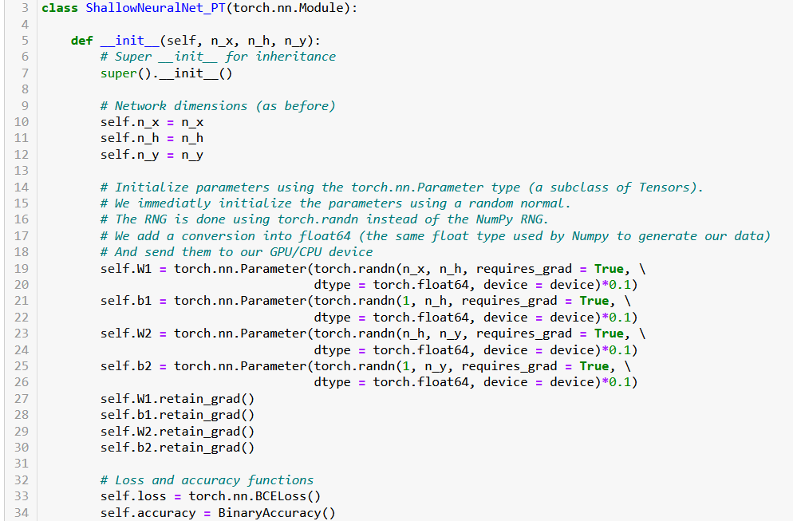

Slide 23
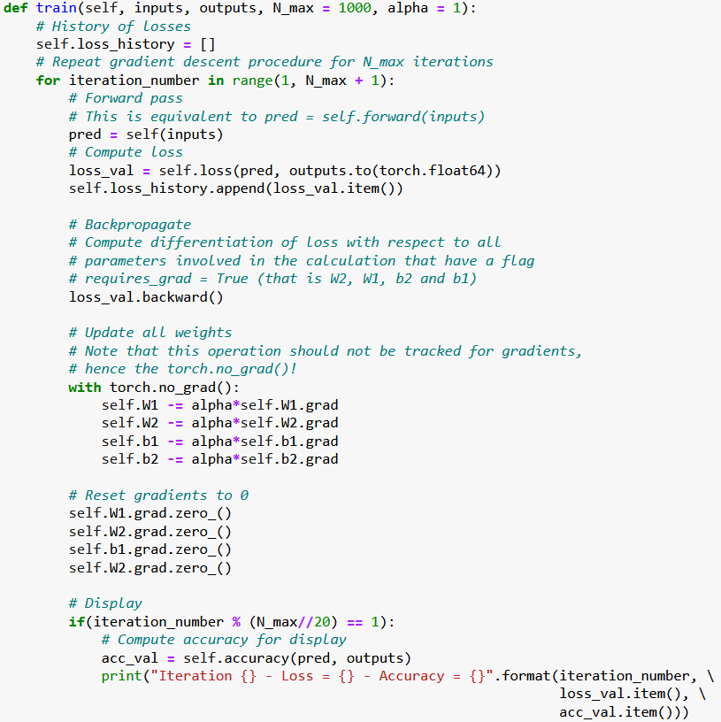

Slide 24
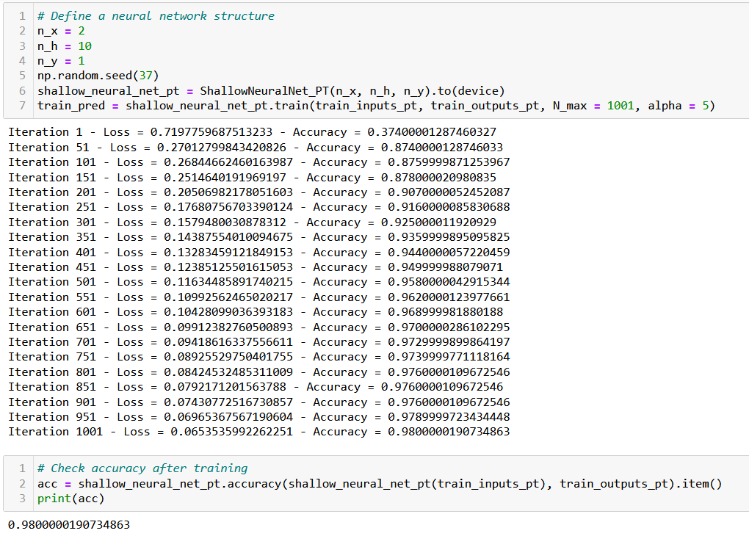

Slide 25
Using advanced optimizers (Adam, etc.)
Our next step is logically to replace our vanilla gradient descent with some more advanced optimizers, e.g. Adam, AdaGrad, RMSProp, etc.
Again, we will be relying on PyTorch as much as possible.
Feel free to have a look at all the available built-in optimizers, available in PyTorch, here: https://pytorch.org/docs/stable/optim.html
Let us now demonstrate how to use them in our Neural Network!

Slide 26
Using advanced optimizers (Adam, etc.)
Three modifications are to be considered to use Adam instead of the Vanilla gradient descent rule.
Adam will be added as an optimizer object and can be passed to the train() method. It will simply consist of an additional variable.
optimizer = torch.optim.Adam(self.parameters(), lr = alpha, betas = (beta1, beta2), eps = 1e-08)
The optimizer.step() is used to update the V and S parameters in Adam. This also realizes the gradient rule update procedure entirely (damn!).
You should remember to reset gradients in optimizer to 0, like you would in the parameters tensors. The operation optimizer.zero_grad() replaces all four self.Xx.grad.zero_() operations we had earlier!

Slide 27
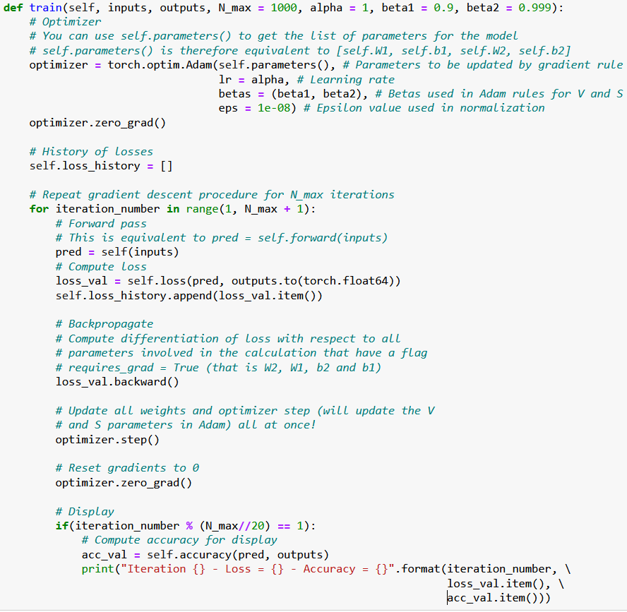

Slide 28
Using advanced optimizers (Adam, etc.)
Feel free to also have a look at the implementation of these optimizers. (You should be able to recognize some concepts from Week 2!) These optimizers come with a few more features that might be worth exploring if you are curious (but we will consider them out-of-scope)!
https://pytorch.org/docs/stable/generated/torch.optim.Adam.html#torch.optim.Adam
Note: implementing your own optimizer is generally a “bad” idea (takes lots of work!), but feel free to look at source codes to see what it takes! https://pytorch.org/docs/stable/_modules/torch/optim/adam.html#Adam

Slide 29
Implementing a stochastic mini-batch GD
We can also define a Stochastic Mini-Batches Gradient Descent procedure. This is typically done with two steps.
Create a Dataset and a Dataloader using the inputs and outputs provided in the train().
(We will learn more about these Dataset and Dataloader objects in the next notebook and lecture. For now, just consider that it allows to conveniently zip the data in an object that is able to shuffle and draw random mini-batches of data for us.)
2. Loop over the mini-batches of data, instead of using the entire inputs/outputs at once, like in (full) batch gradient descent.

Slide 30
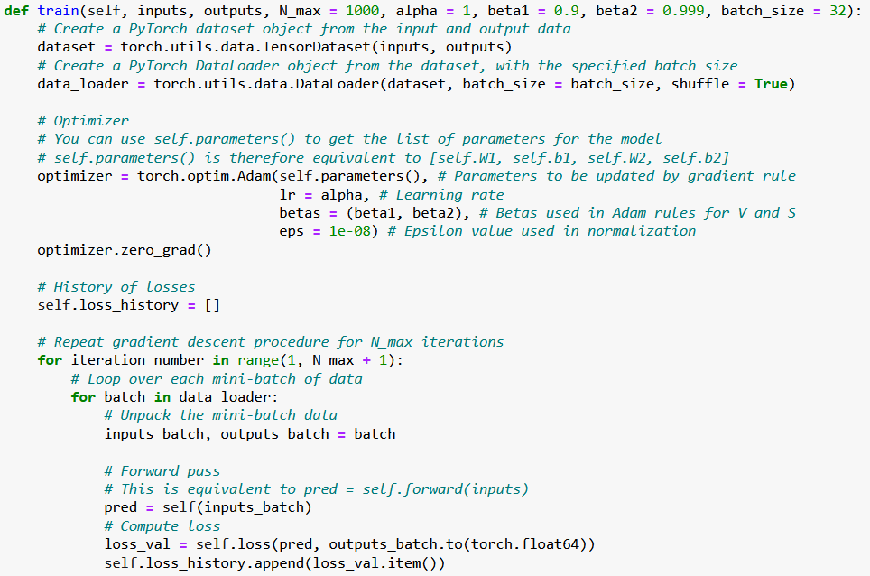

Slide 31
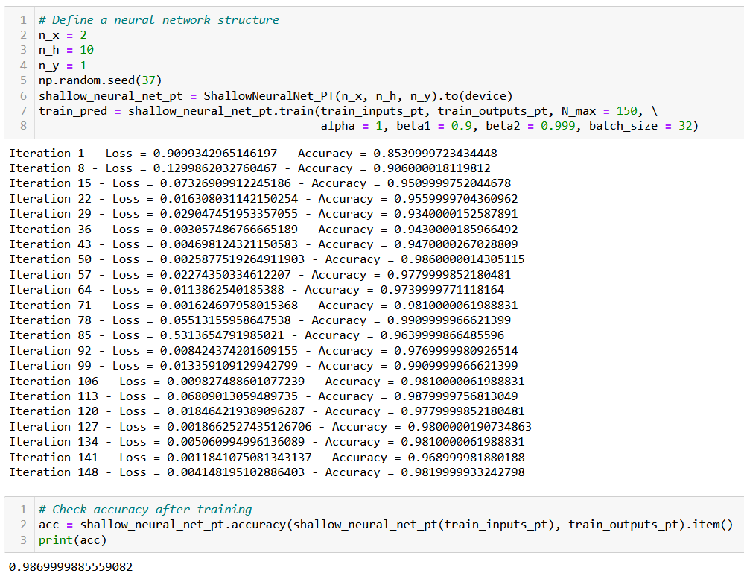

Slide 32
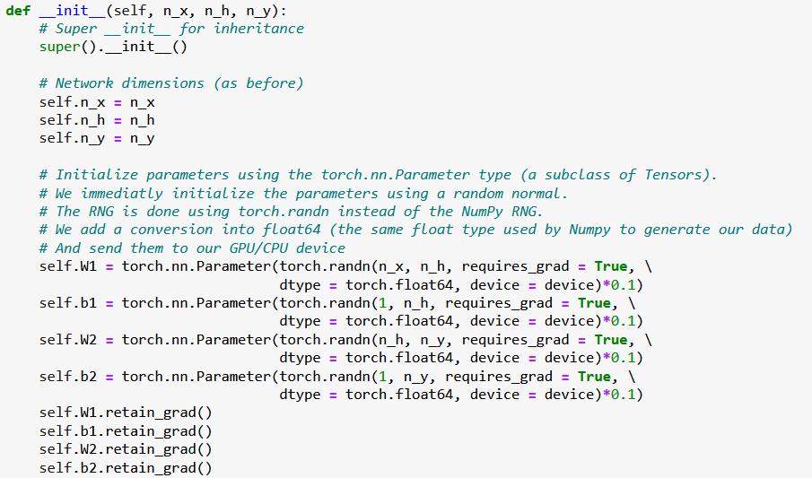
Better initializers in PyTorch
This part is a bit tedious and relies on our own manual implementation of a random normal initializer.
Need to replace these RNG with built-in PyTorch initializers!

Slide 33
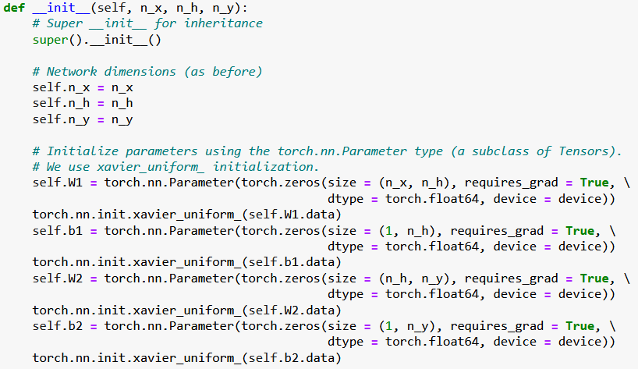
Better initializers in PyTorch
Fixed!
Feel free to have a look at this for additional initializers in PyTorch.
https://pytorch.org/cppdocs/api/file_torch_csrc_api_include_torch_nn_init.h.html#file-torch-csrc-api-include-torch-nn-init-h

Slide 34
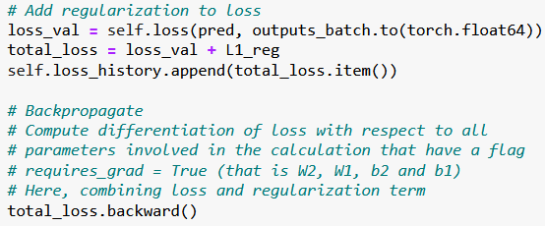

Adding a regularization to our loss
We have also seen during Ridge Regression (on Week 1) that it is sometimes beneficial to add a regularization term to our loss functions.
Our first step would be to simply compute our regularization term by using the PyTorch functions, for instance the L1 loss.
We would then simply add it to the loss before backpropagating.

Slide 35
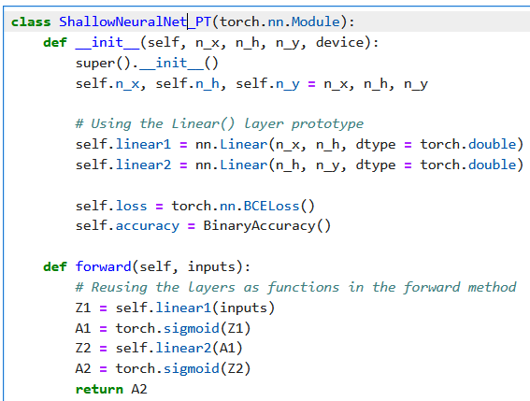
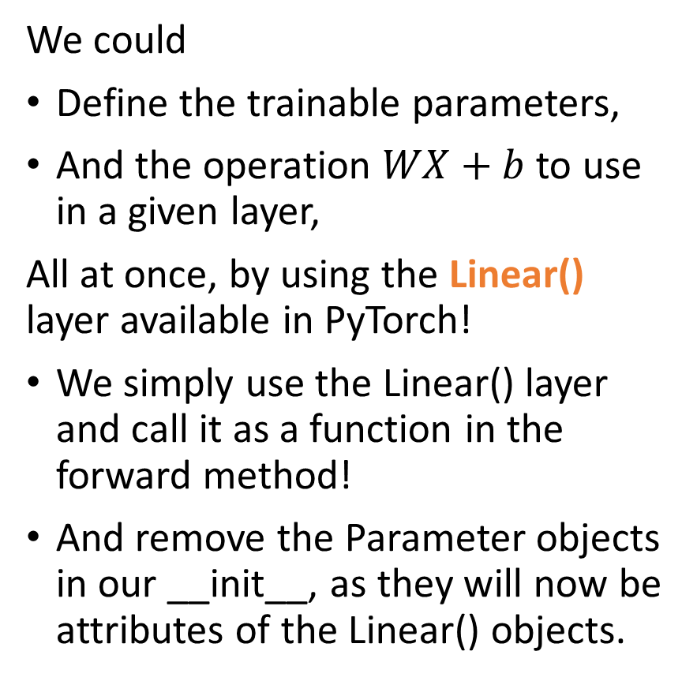
Last but not least, using layers prototypes
We could
Define the trainable parameters,
And the operation $WX+b$to use in a given layer,
All at once, by using the Linear() layer available in PyTorch!
We simply use the Linear() layer and call it as a function in the forward method!
And remove the Parameter objects in our __init__, as they will now be attributes of the Linear() objects.

Slide 36
To summarize
We now have a full Neural Network class, written in PyTorch, with:
2 linear layers, sigmoid activation functions,
Xavier uniform initialization on trainable parameters,
Forward pass method,
Autograd backpropagation and trainer method,
Adam optimizer,
Dataloader allowing for stochastic mini-batches,
Cross-entropy loss and accuracies,
L1 regularization.
And it runs/trains at the speed of light (almost…) on GPU!

Slide 37
